Slide 1
Photomicrographs of Plant foods
Pear: Asian & European
Permission to reproduce original photomicrographs used to make this collection may be obtained from
Dr. David O. Norris at
david.norris@colorado.edu

Slide 2
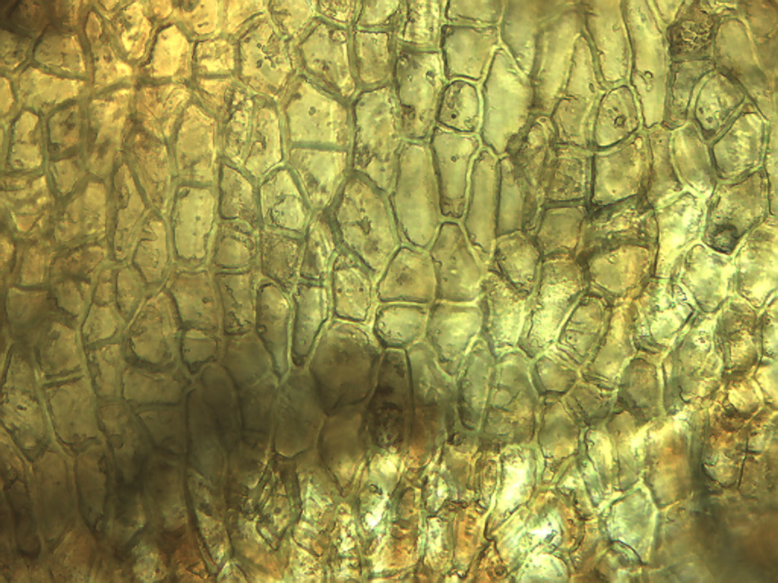
Notes:
362. Pyrus ussuriensis Maxim. Pear, Asian. Epidermal cells of Asian pear skin, 25X.

Slide 3
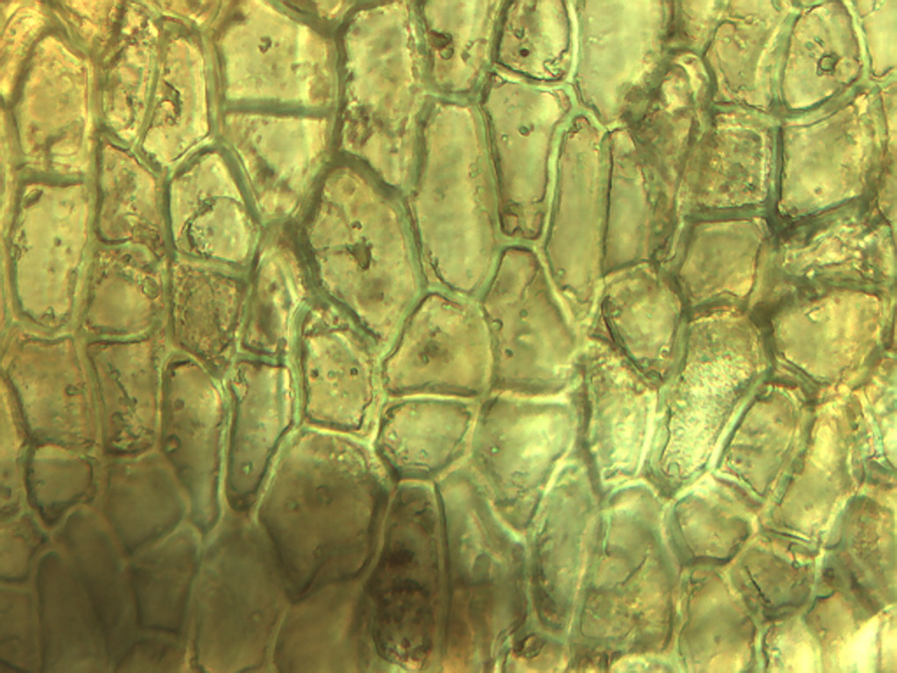
Notes:
363. Pear, Asian. Epidermal cells of Asian pear skin, 40X. Compare to tomato skin.

Slide 4
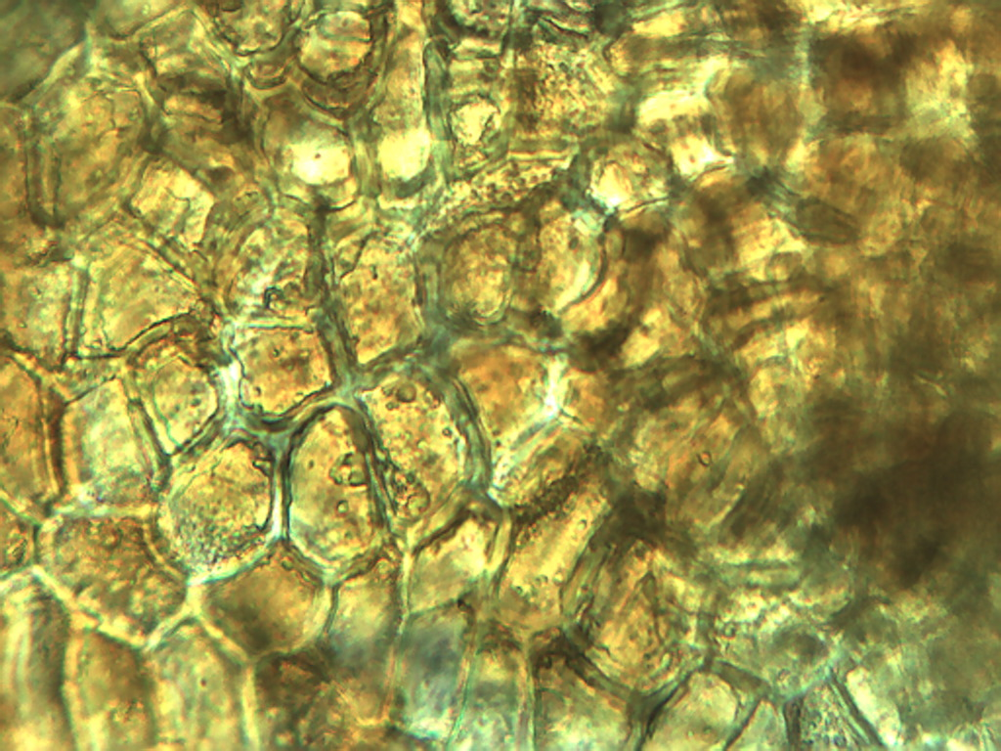
Notes:
364. Pear, Asian. Skin epidermis, 40X

Slide 5
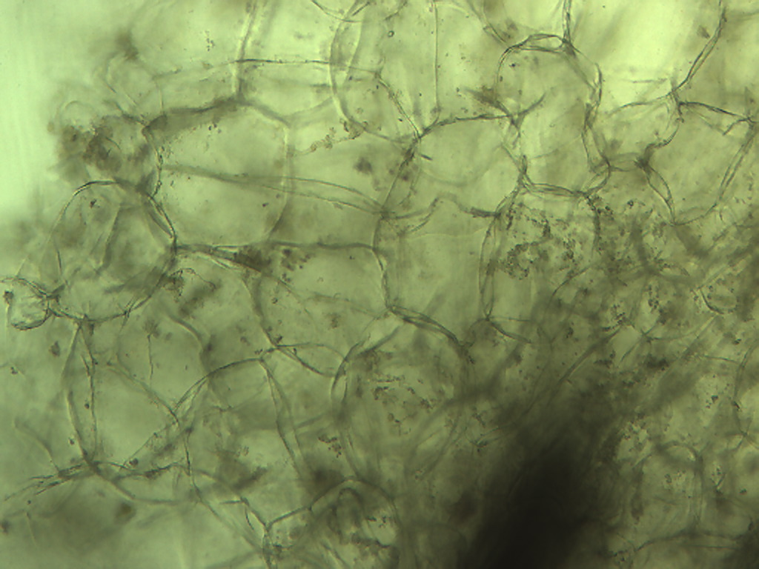
Notes:
365. Pear, Asian; pulp cells. 10X.

Slide 6
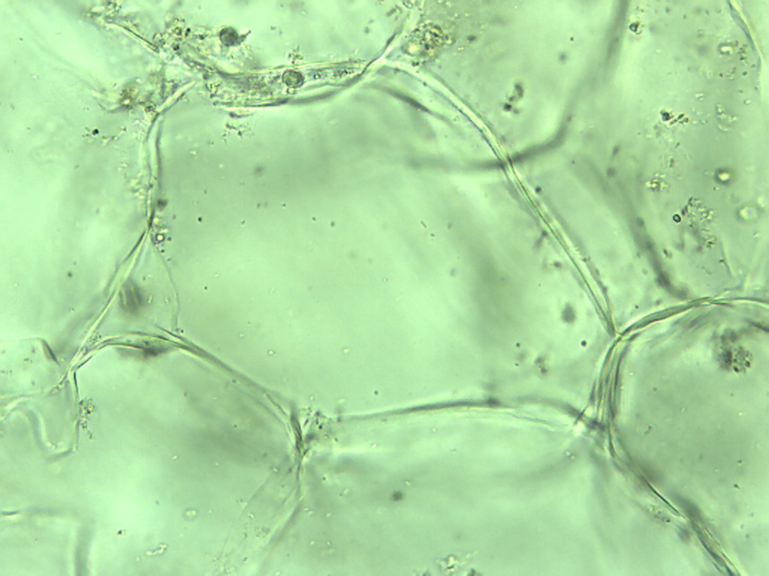
Notes:
366. Pear, Asian. Pulp parenchymal cells. 25X.

Slide 7
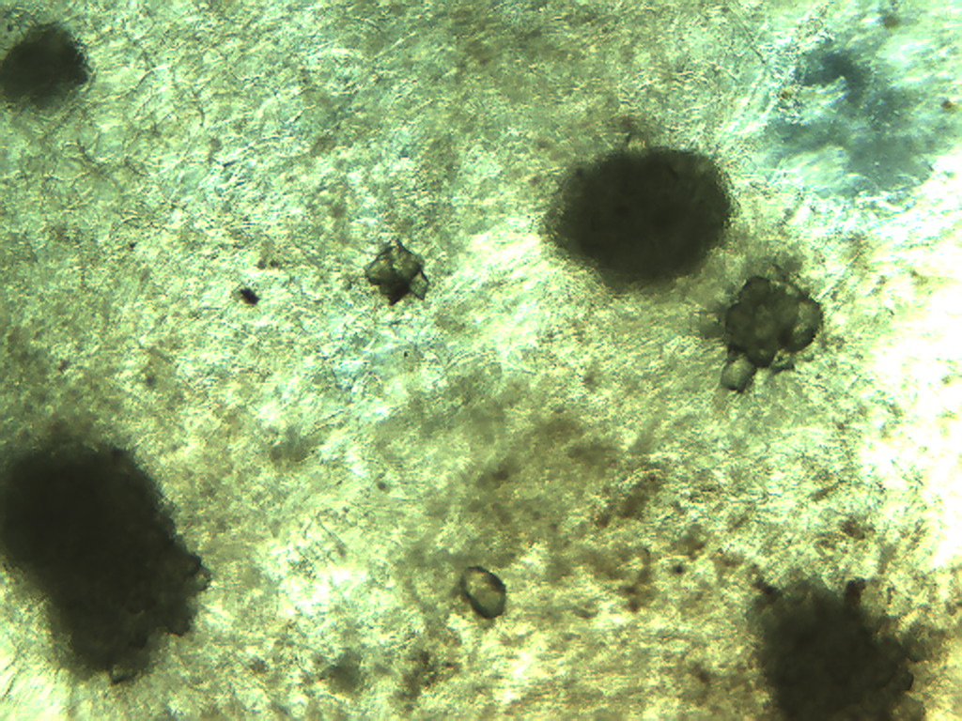
Notes:
367.Pear, Asian. Sclerid clumps (arrows) of various sizes in pulp, 4X.

Slide 8
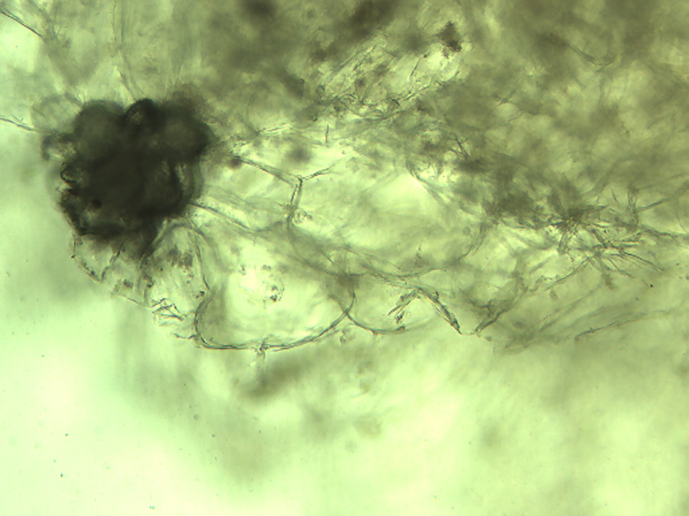
Notes:
368. Pear, Asian. Pulp parenchymal cells and sclerid inclusion, 10X.

Slide 9
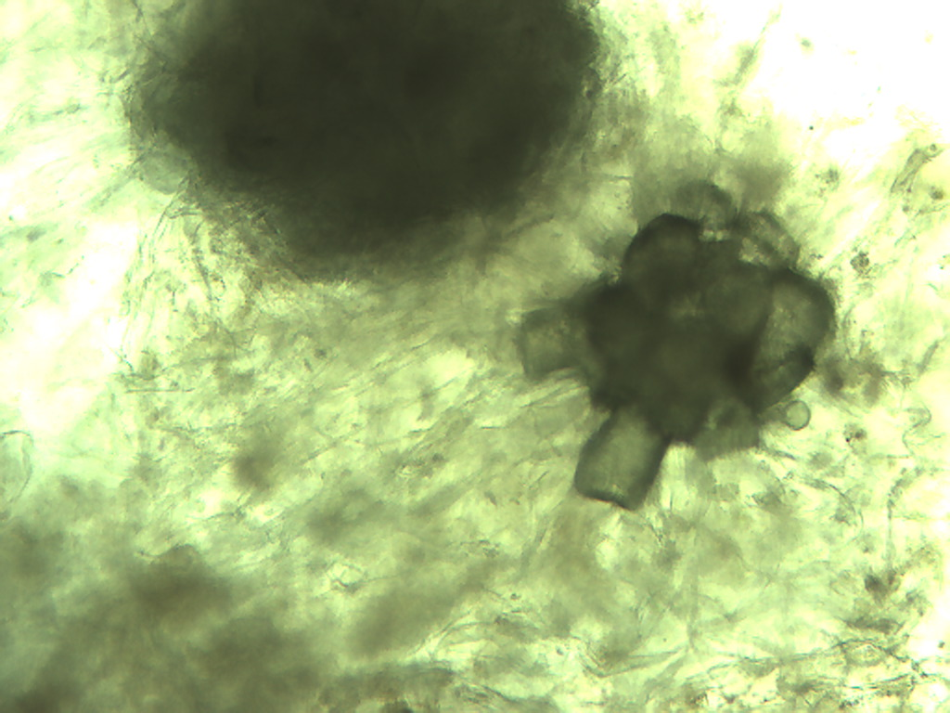
Notes:
369. Pear, Asian. Smaller inclusion showing individual sclerids, 10X

Slide 10
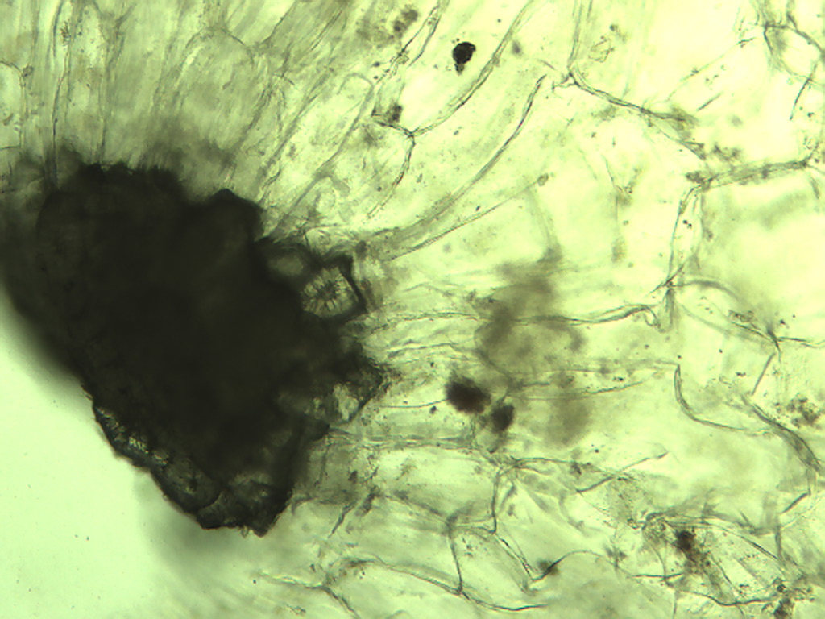
Notes:
370. Pear, Asian. Composite inclusion consisting of individual sclerids (arrow indicates one sclerid in cross-section), 10X

Slide 11
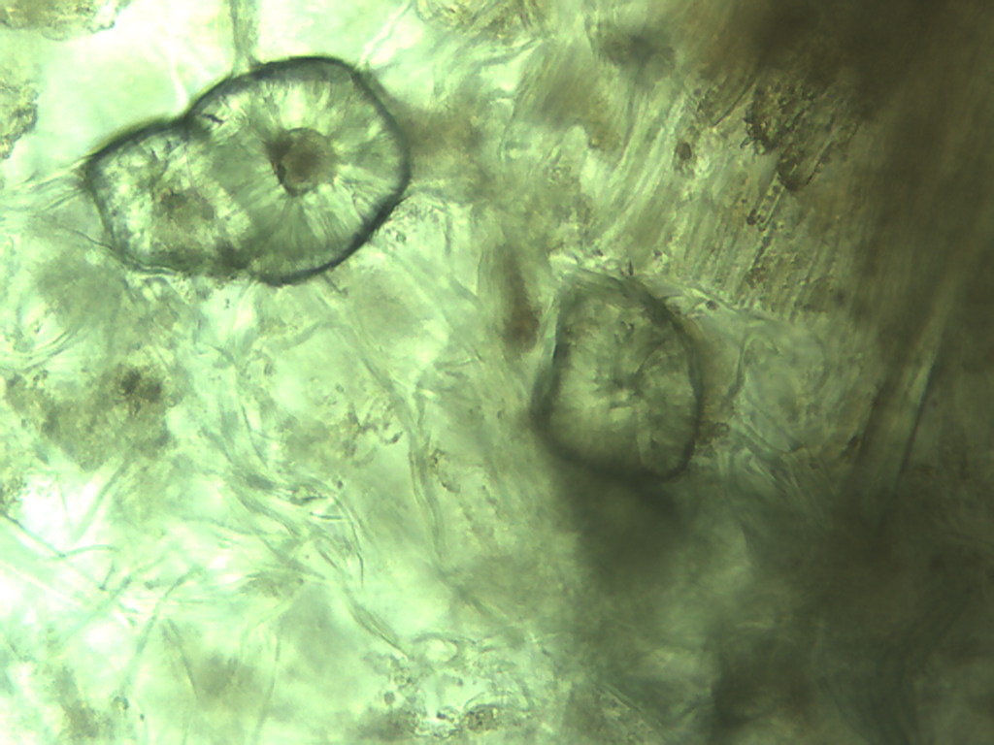
Notes:
371. Pear, Asian. Individual sclerids separate from composite clump, 25X.

Slide 12
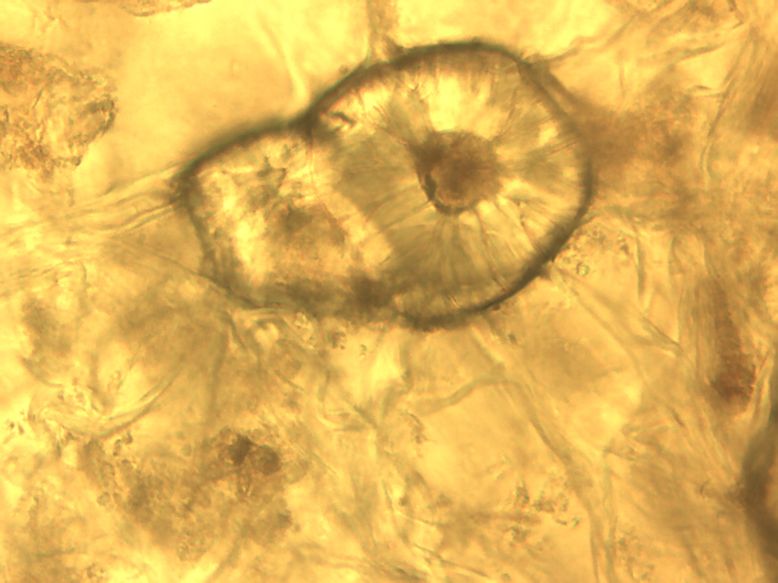
Notes:
372. Pear, Asian. Sclerid cross-section, no filter. 40X.

Slide 13
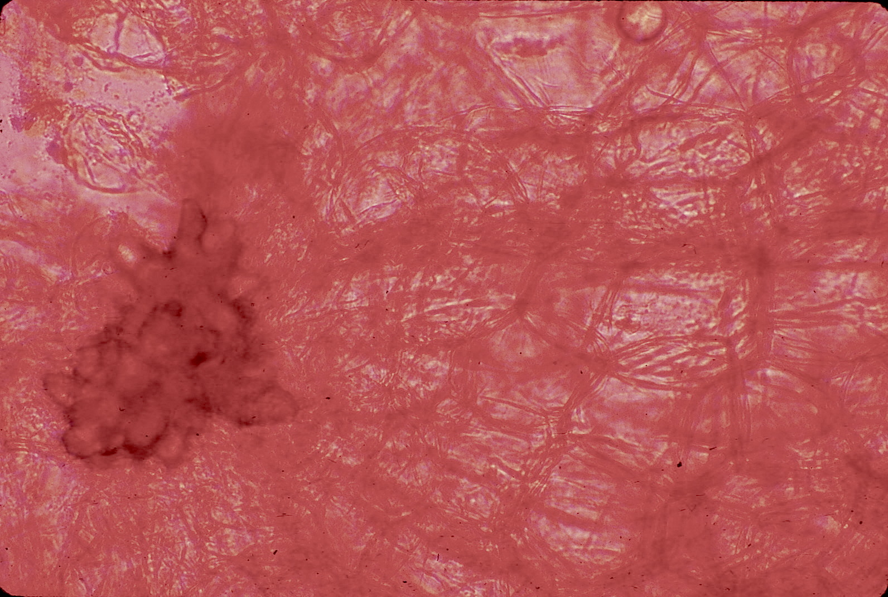
Notes:
361. Pyrus communis L. Pear. Sclerid (stone cells) in pear pulp (arrow) among parenchymal cells, stained with safranin, 10X

